Slide 1
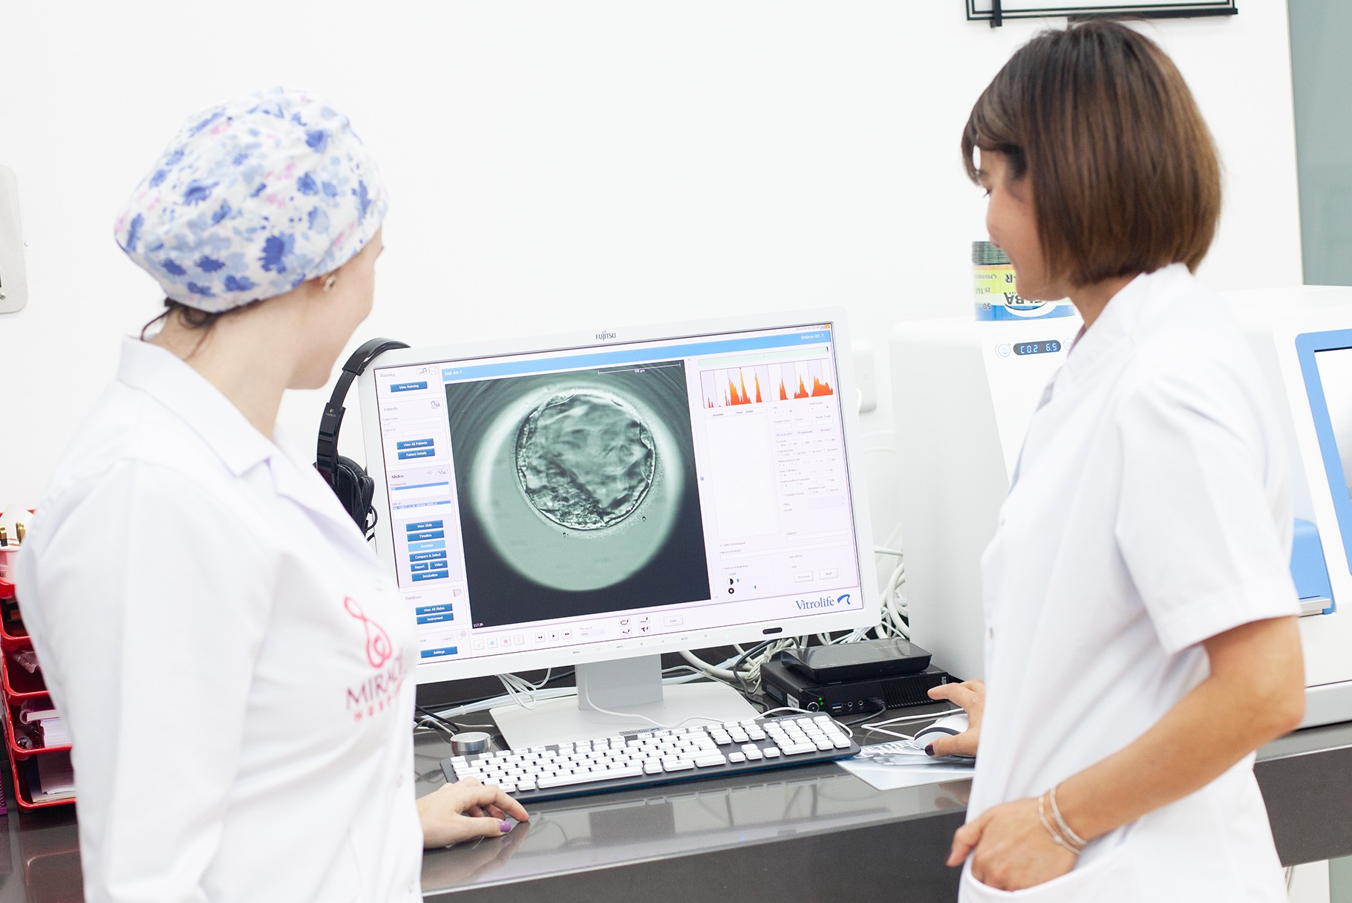
AI/ML Project – Embryo Analysis to Improve Success Rate of IVF
This Photo is from link

Slide 2



Team Introduction
Project External
Professor
This Photo is from link
Group Number - 13
Amal Mathew
Nobin Ann Mathew: 0768877
Anjana Padikkal Veetil: 0780343
Teja Maridu
Santosh Kumar Kantimahanti
Eric Tang, EDC - Mobile App
Dr. Umair Durrani, PhD

Slide 3
Content
Introduction
Background
Research Objectives
Data Description
Description
Preprocessing
Methods
Results
Future work
Demo

Slide 4

Introduction
EDC - Mobile App
They develops applications for various industries

Slide 5
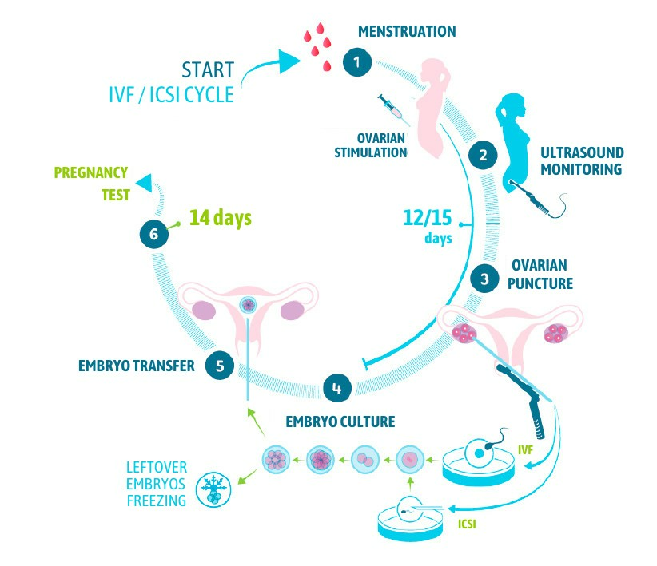
Introduction
In vitro fertilization (IVF) is an
assistive reproductive technology
Current IVF method Steps
1) Ovarian stimulation
2) Ovarian puncher/ Egg collection
3) Embryo culture
4) Embryo Transfer
5) Pregnancy Test

Slide 6
Introduction
Manual grading of blastocyst images
Precise
Time consuming
Cause human error
STORK alone cannot estimate the pregnancy rate.
Can detect the association between embryo quality and pregnancy rate based on morphological characteristics

Slide 7
Research Objectives
How can a machine learning model be incorporated into the morphological analysis of an embryo in IVF which would eliminate the factor of human error and could result in better success rate ?
How much resources (time and cost) can be saved in the morphological analysis process by implementing the proposed machine learning model ?

Slide 8
Data Description
269 total blastocysts images of RBG format.
Combined two datasets: SFU, STORK.
Year of collection: 2012 to 2016
Dataset: https://vault.sfu.ca/index.php/s/066vGJfviJMYuP6?path=%2F
GitHub: https://github.com/ih-lab/STORK

Slide 9
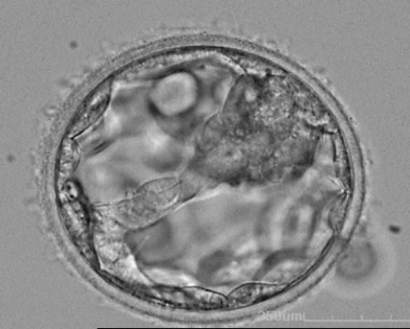
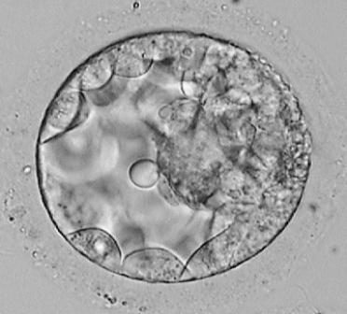
Data Description
Preprocessing
Labelled embryo images as good or poor quality, Based on an embryologist's decision of implanting the embryo.
Dataset
Good Quality Images
Poor Quality Images
118 Images
102 Images

Slide 10
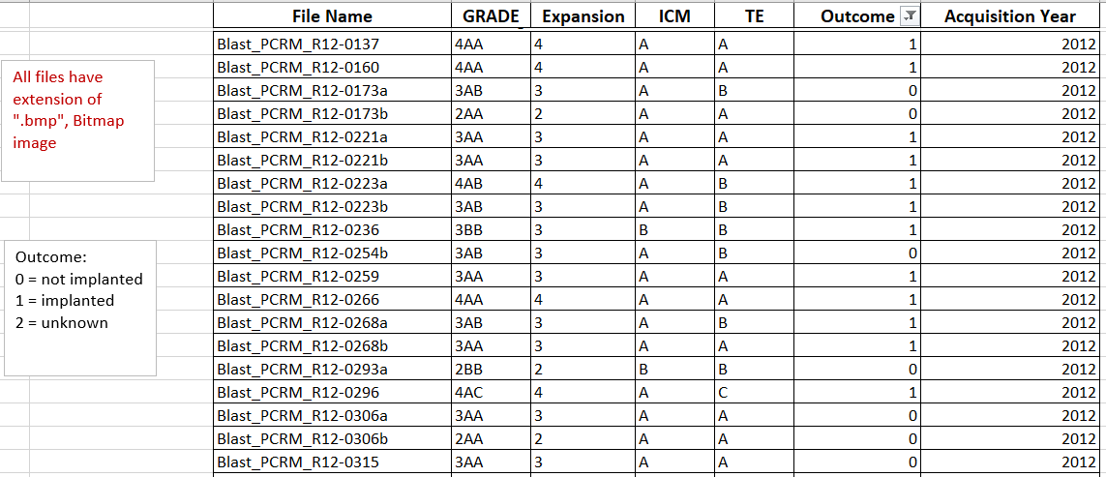
Data Description
Ground Truth segmentation results

Slide 11
Methods
The framework used is STORK was developed based on Google's Inception model.
Test Data
20%
Train Data
80%
Inception-V1 algorithm of Deep Neural Network is used to train the dataset.
Python: 2.7
Tensorflow: 1.15
TF-Slim package: Defining, training, and evaluating models in TensorFlow.

Slide 12
Methods
Evaluation Metrics
Precision – 95%
Accuracy
This is the fraction of correctly identified images.
96 %

Slide 13
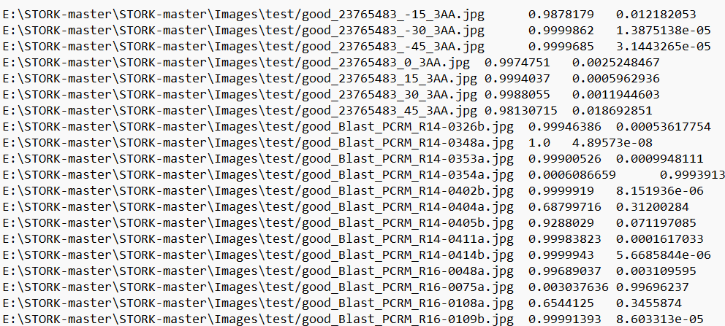
Results
Accuracy
(47, 49, 0.95)
95 %

Slide 14
Conclusions
Using Inception-V1 model, we are able to classify the embryo as either Good/Bad for implantation.
We are getting a precision of 0.95 in embryo image analysis.
We secured an accuracy of 96%.

Slide 15
Future work
Semantic segmentation in Image processing can further be used for clustering embryo components which can help in better grading of embryos.
SSS-Net model for embryo component classification can be used to compare the accuracy with the current model.
The training set for this analysis is relatively small for a deep learning task, so there is likely room for improvement here.

Slide 16
References
https://github.com/ih-lab/STORK
https://www.nature.com/articles/s41746-019-0096-y

Slide 17
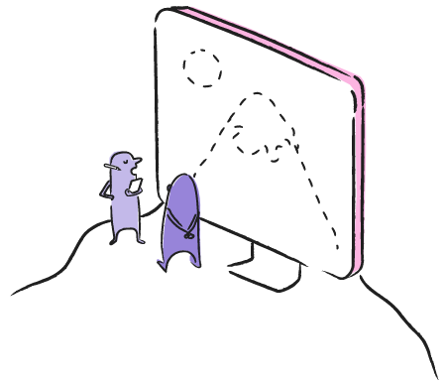
Demo
Thank you Let's see the demo of the product

